Slide 1
KAUNAS UNIVERSITY OF TECHNOLOGY INFORMATICS FACULTY
Feature transferability in images with ResNet50
Initial project presentation
Project author: Vitalija Serapinaitė
Lecturer: assoc. prof. Kęstutis Jankauskas
KAUNAS, 2021

Slide 2
Relevance
To have an algorithm that groups unseen images without training is important because:
Number of images is increasing;
Resources are mostly limited;
Reduces time for initial analysis part.

Slide 3
Goal and Objectives
Goal: create an algorithm that groups seen and unseen images using ResNet50 embeddings.
Objectives:
Create blackbox model and save average embeddings of 15 different class images;
Implement logic that groups familiar and unfamiliar classes using blackbox embeddings;
Test the algorithm on 15 unfamiliar classes with known labels and 5 familiar classes, compare results with existing models.

Slide 4
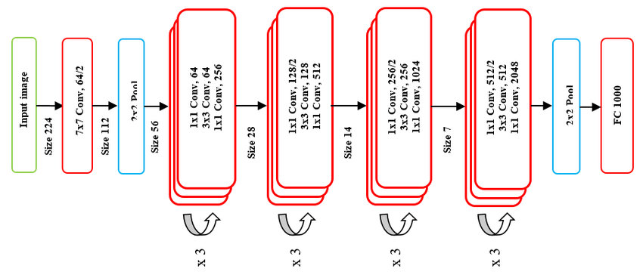
Method Analysis
ResNet50 [1]
Notes:
ResNet 50

Slide 5
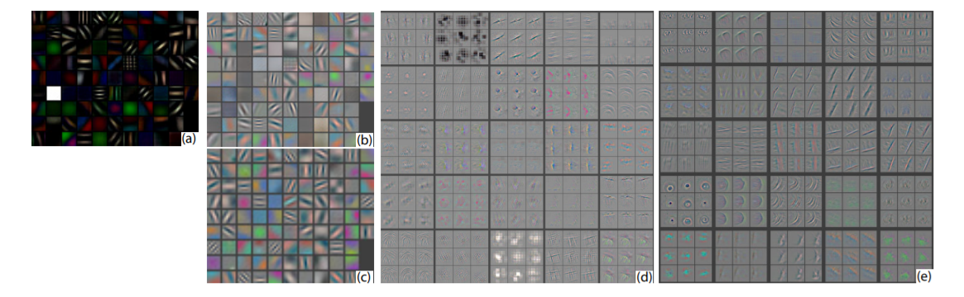
Method Analysis
What CNNs see? [2]

Slide 6
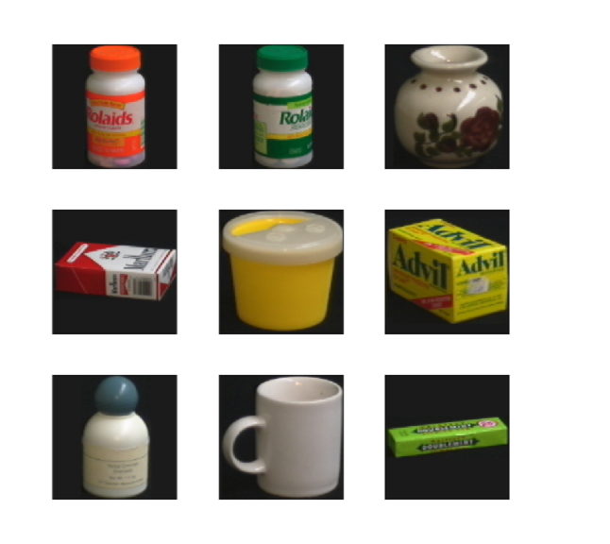
Method Analysis
Columbia Object Image Library (COIL-100) Dataset [3]

Slide 7
Method Analysis
Need an algorithm that:
Stores information about current embedding space and location of known classes embeddings;
Finds images with which model is familiar;
Creates new clusters for unfamiliar embeddings;
Assigns new embeddings to clusters.
Notes:
ResNet 50

Slide 8
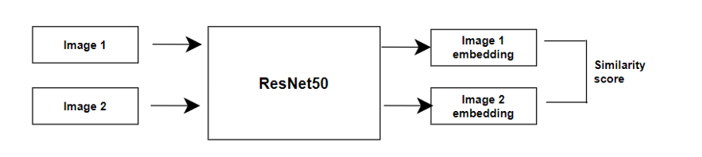
Implementation: blackbox
Blackbox model is used to find the distances between two images.

Slide 9
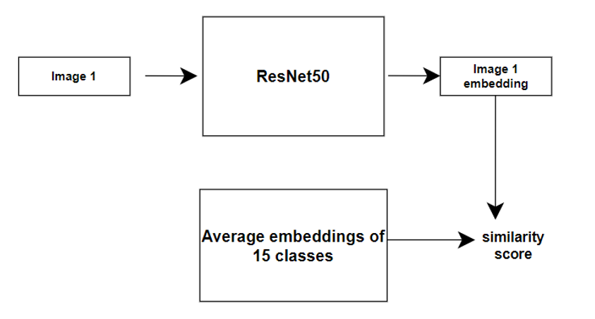
Implementation: blackbox
Blackbox model is used to find the distances between familiar embeddings and new image.

Slide 10
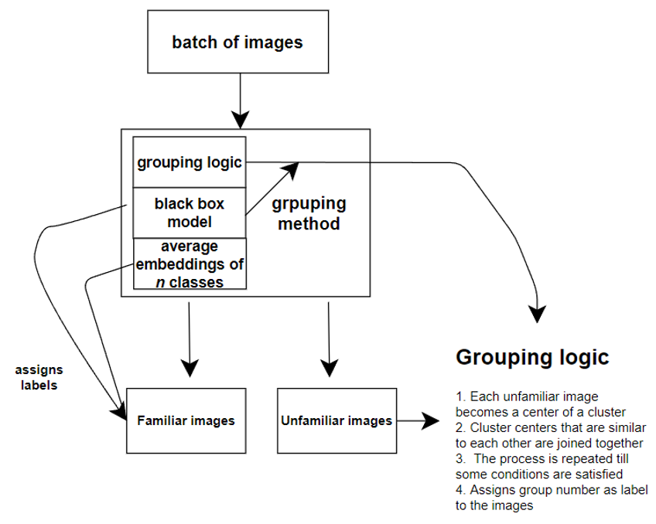
Implementation: grouping model
Grouping model implementation.

Slide 11
Result comparison
Purity measures how homogenous clusters are.
High purity, homogenous cluster
Low purity, heterogeneous cluster

Slide 12
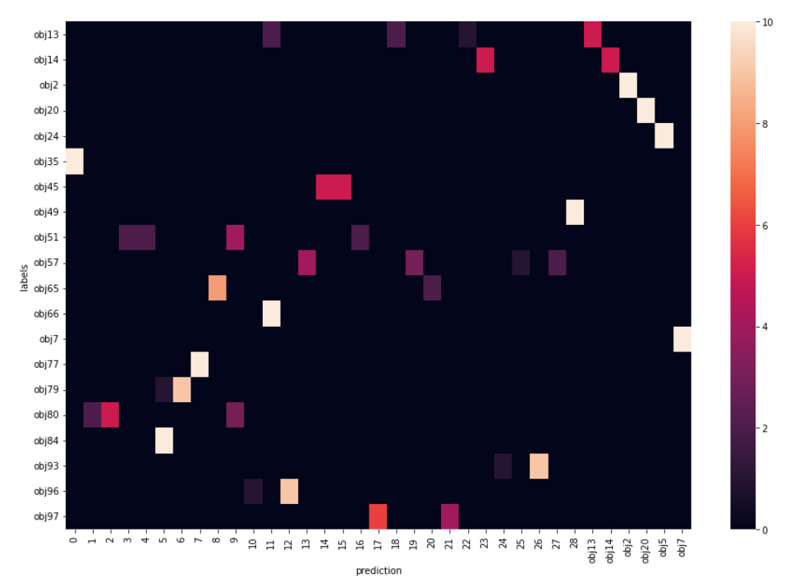
Result comparison
Grouping results on 15 unfamiliar and 5 familiar classes samples.

Slide 13
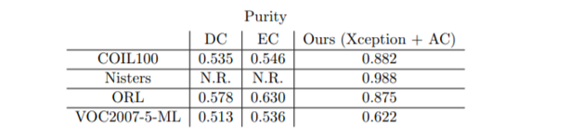
Result comparison
Metrics: purity (measures how homogenous clusters are)
Results: 0.97 purity which is pretty good but only because of low class number.
Guerin, J.; Gibaru, O.; Thiery, S.; Nyiri, E. CNN features are also great at unsupervised classification [interactive]. arXiv 2017, arXiv:1707.01700 [5]
Notes:
ResNet 50

Slide 14
Conclusions
Implemented blackbox model that uses ResNet50 for feature extraction and Euclidean distance to determine similarity. BAD
The grouping algorithm can assign new images to familiar classes or create additional clusters.
The algorithm tested on 15 unfamiliar and 5 familiar classes (10 images each) had 0.98 purity. Xception feature extractor and agglomerative clustering method [5] together reached 0.882 purity.
Notes:
The algorithm might work better (based on purity) than state-of-the-art method of 2018. But more testing is required.

Slide 15
Sources
https://www.researchgate.net/figure/The-proposed-Resnet50-CNN-architecture_fig3_338253578
https://arxiv.org/pdf/1311.2901.pdf
https://www.kaggle.com/jessicali9530/coil100
https://www.researchgate.net/figure/Example-on-KNN-classifier_fig1_331424423
https://arxiv.org/pdf/1707.01700.pdf

